Slide 1


PDF GENIE: INTERACTIVE Q&A WITH ADVANCED AI INTEGRATION
Team Members:
Reshma R - 210701212
Sangeetha G - 210701229

Slide 2



CONTENTS
1
Introduction
2
Existing System
3
Technologies Used
4
Proposed System
5
Architecture of the system
6
Implementation
7
Output
8
Conclusion and Future Enhancement

Slide 3



1
Introduction
The "PDF GENIE: INTERACTIVE Q&A WITH ADVANCED AI INTEGRATION" project introduces a transformative approach to interacting with PDF documents.
The chatbot processes user queries, retrieves relevant information from the PDF content, and provides accurate responses, thereby enhancing document accessibility and efficiency in information retrieval.

Slide 4



2
EXISTING SYSTEM
MANUAL SEARCH AND READ WHICH CAN BE VERY CUMBERSOME ESPECIALLY ON LARGE DOCUMENTS
TRADITIONAL SEARCH FUNCTIONS DO NOT SEEM TO RECOGNIZE THE CONTEXT NECESSARY TO UNDERSTAND ADVANCED REQUESTS

Slide 5

3
Technologies used
Large Language Model
Summarize lengthy documents
Langchain
Language Model Framework
Pinecone DB
Vector Database Service
Vercel AI SDK
Rapid Deployment Toolkit
Next Js
React JS Framework

Slide 6



4
PROPOSED system
USER INTERFACE AND PDF PROCESSING
KNOWLEDGE STORE AND RETRIEVAL
INTELLIGENT INTERACTION AND RESPONSE GENERATION

Slide 7
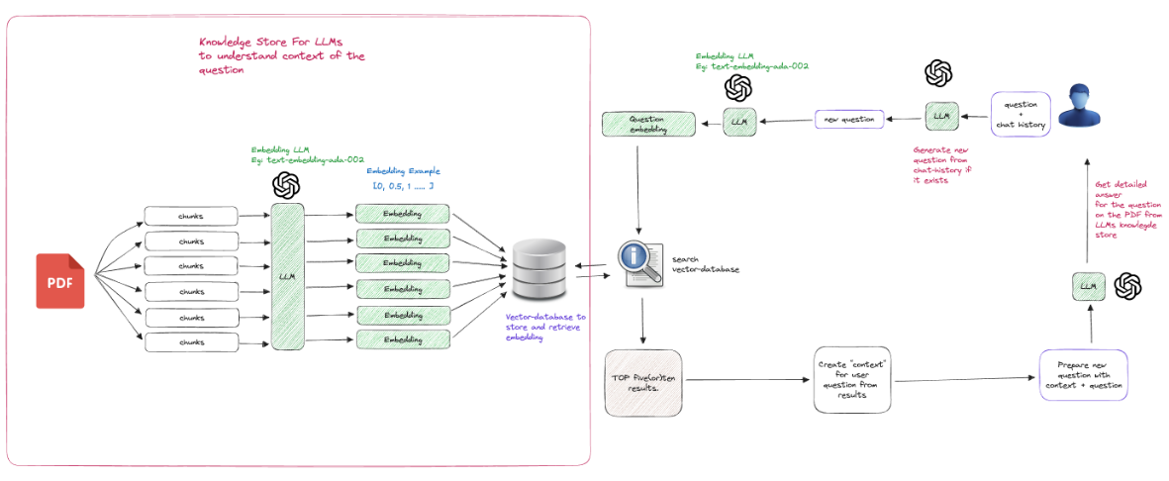
5
ARCHITECTURE OF THE SYSTEM

Slide 8


6
IMPLEMENTATION
User interface module
PDF PROCESSING MODULE
It guarantees an easy and beautiful interface for the users who upload PDF files and deal with the chatbot. Using the Shadcn UI component library, the interface is silky smooth and thoroughly optimized, creating a more engaging and efficient use of the system.
It reads text and metadata from the PDFs, and transforms these into indexed data storage forms. This module also aids in preparing the extracted information for further analysis to enhance its accuracy and integrity. The efficiency of parsing and conversion is addressed

Slide 9
KNOWLEDGE STORE MODULE
CHATBOT INTERACTION MODULE
It is the backend module that maintains and indexes the PDF documents which have been identified as important by the search engine. It takes advantage of Pinecone DB to optimally store datasets with high dimensionality to enable the quick and efficient search for documents.
It takes user inputs, searches the knowledge base for related information and constructs meaningful responses utilizing sophisticated language models. This module is responsible for understanding the user inputs and queries, as well as providing meaningful responses pertinent to the query.

Slide 10
LANGCHAIN INTEGRATION MODULE
It is a module that coordinates the series of operations that occur between identifying the user’s query and providing a response. It combines multiple language models to provide syntactically and semantically correct answers to the posed questions.

Slide 11
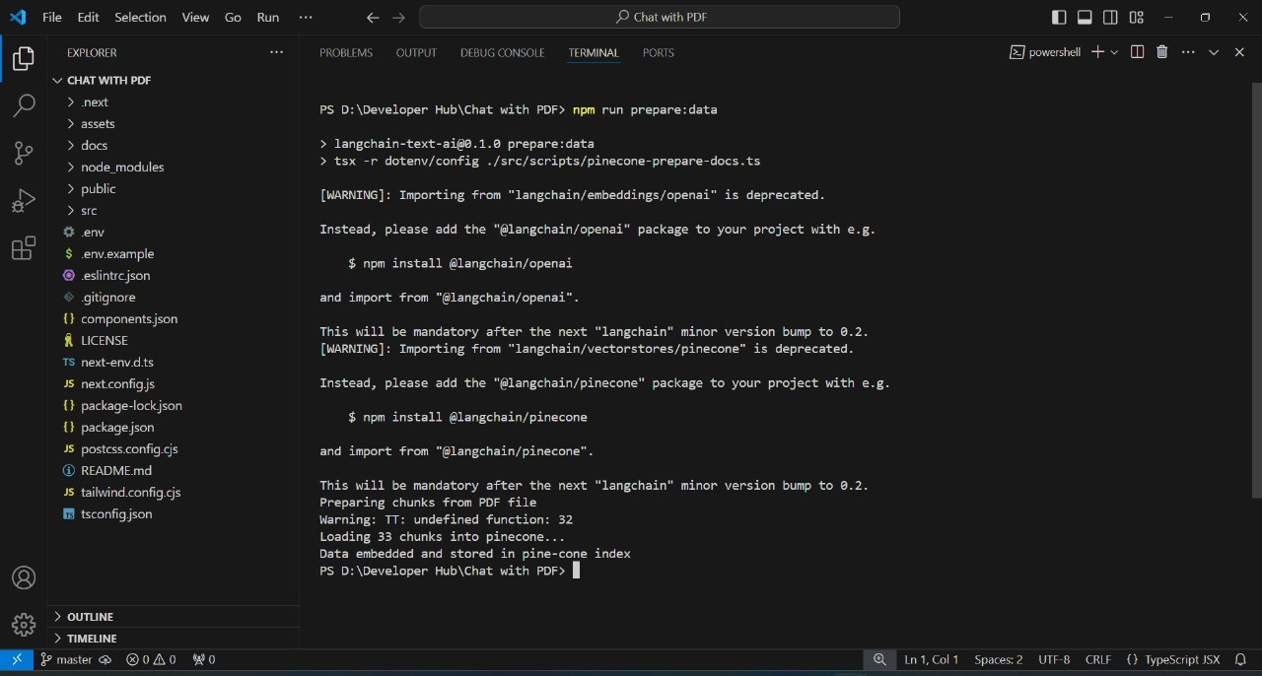
7
OUTPUT

Slide 12
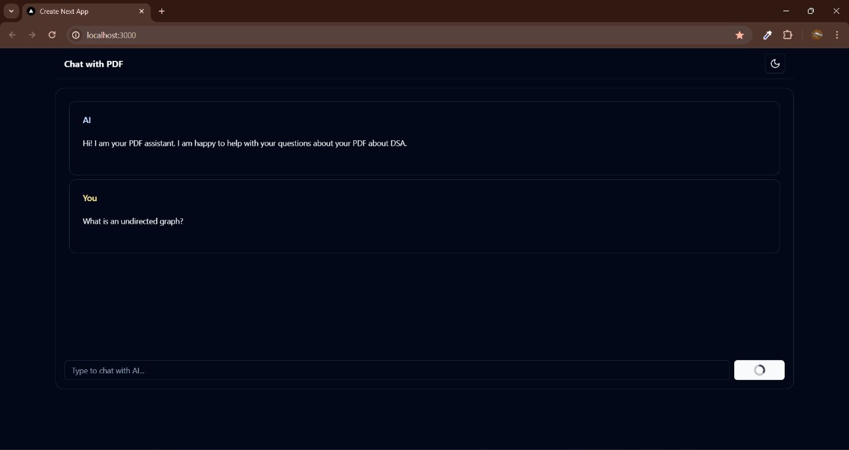
User Prompt and Query Processing

Slide 13
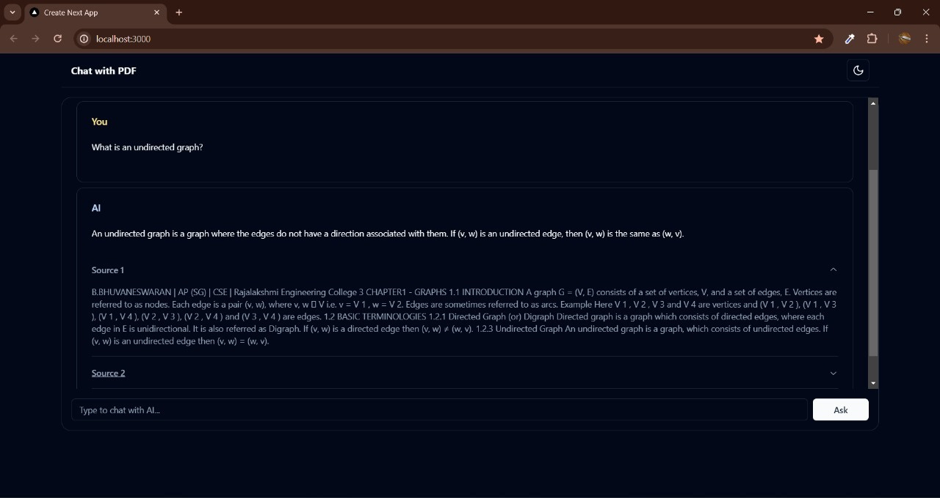
Intelligent Interaction and Response Generation

Slide 14



CONCLUSION & FUTURE ENHANCEMENT

Slide 15


The "PDF GENIE" project leverages AI, including LLMs, LangChain, PineconeDB, and Vercel AI SDK, to transform static PDFs into interactive tools, enhancing information retrieval and usability across various fields.
Future enhancements for "PDF GENIE" include multi-language support, advanced NLU capabilities, OCR integration for scanned documents, personalized responses, improved cloud integration, and enhanced security measures for user data protection.

Slide 16
Thank you

